Slide 1
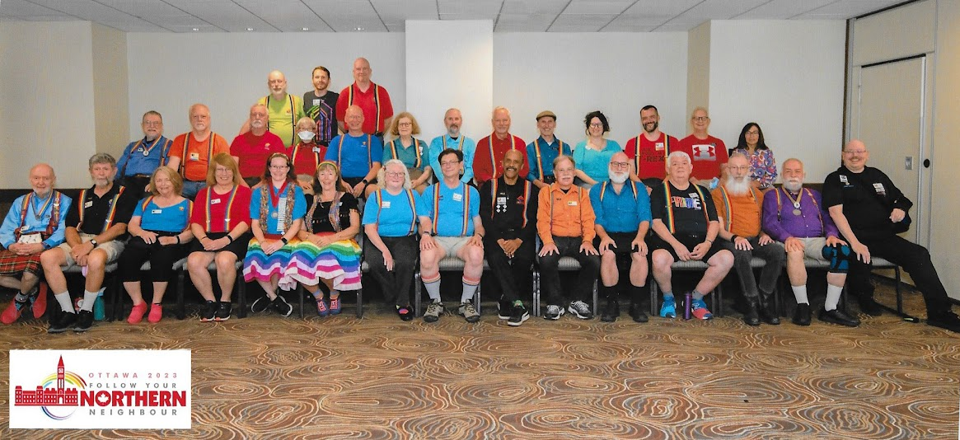
EL CAMINO REELERS
GENERAL MEETING
TUESDAY, FEBRUARY 6, 2024
Notes:
Need a picture

Slide 2
Agenda
2023 in Review (Michael)
Membership & Financial Summary (Ed)
Board Elections (Jeff)
The Future (Oliver)
Acknowledgments (Michael)

Slide 3
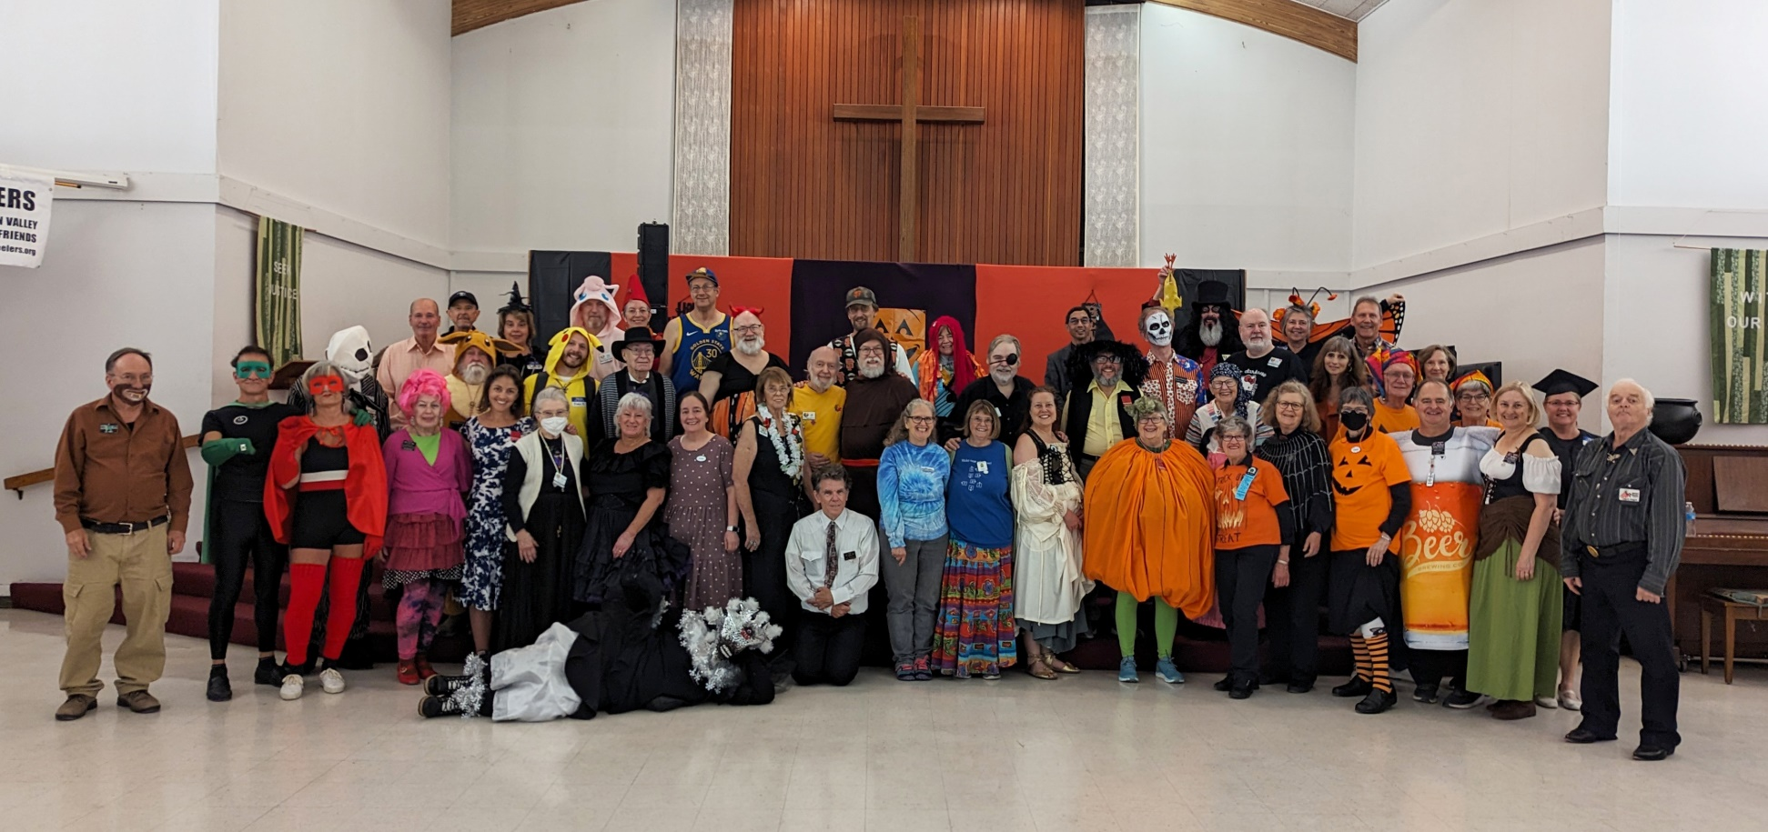
2023 in Review
What did we do last year?

Slide 4
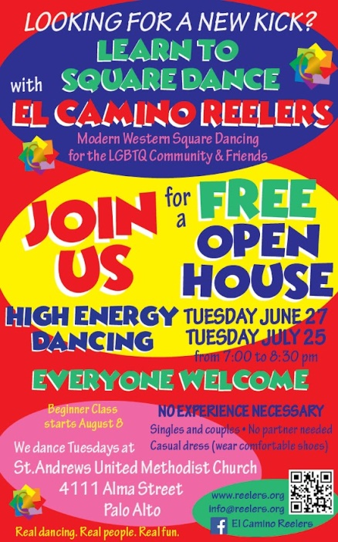
Grew the club…
Growing our membership was priority #1
Open House nights in January and July
“Orange” Blast Class: February-April
“Yellow” Beginner class: August-October
Focus on SSD dancing on Tuesday club nights
4 new members 3 returning members (and several dropouts)

Slide 5
… Kept it fun for old-timers…
With all the SSD, we needed events for Plus/A2 dancers:
The Thursday night experiment (thanks, Jeff!)
Two Sunday Tea Dances at Billy DeFrank Center

Slide 6
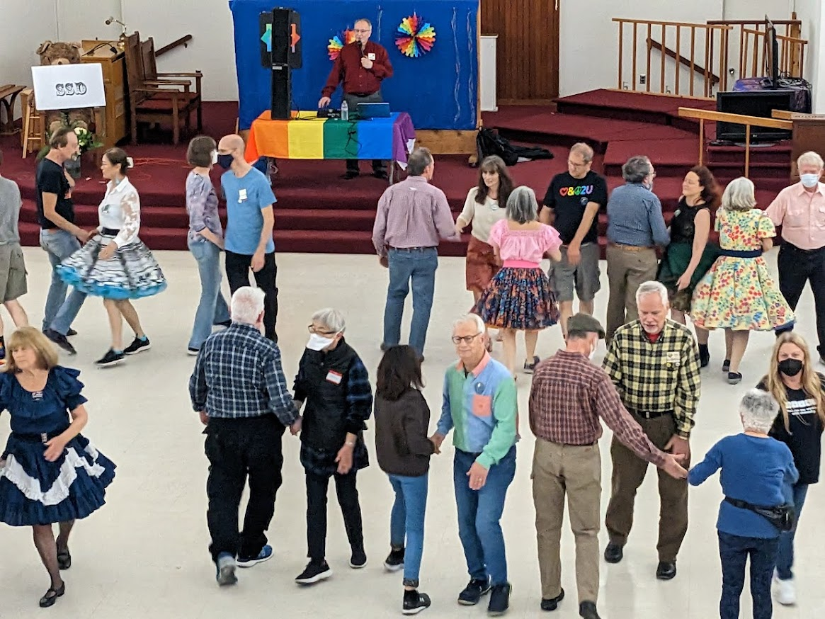
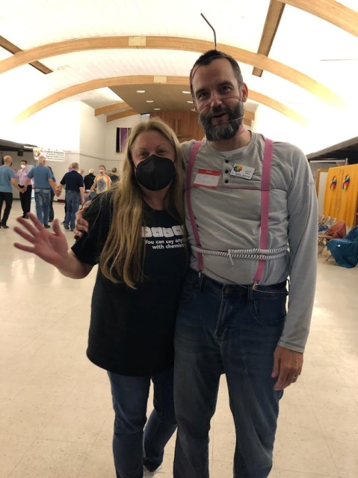
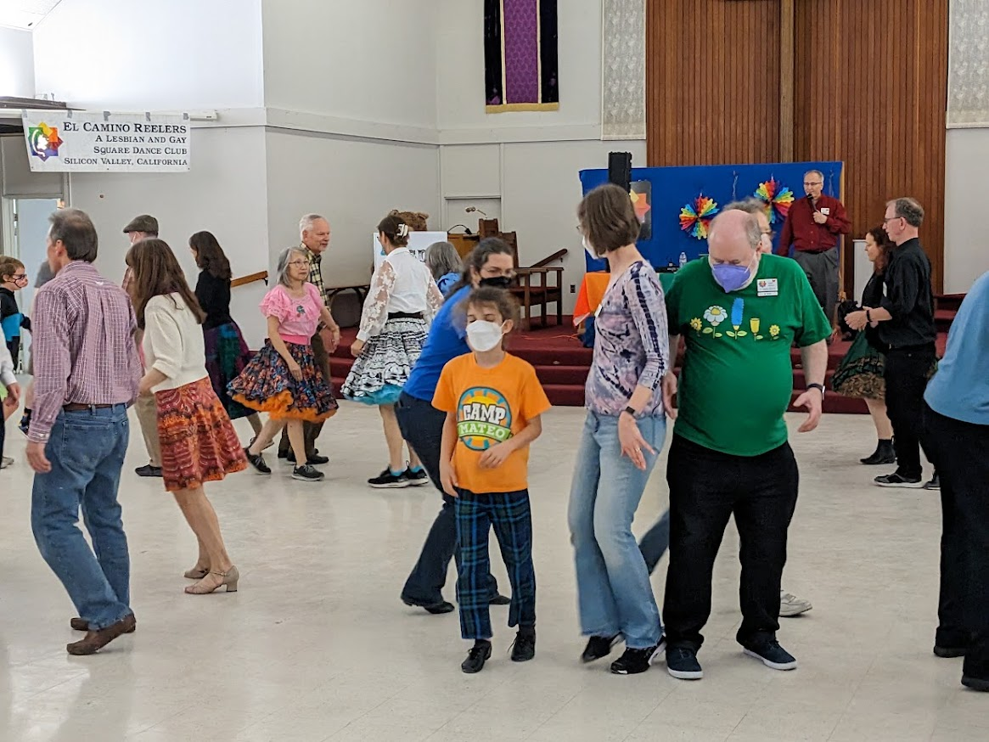
Walked and dodged…

Slide 7
Ate Pizza…
The April pizza party was a test to see if ECR folks were ready to go back to eating together indoors again.
(We passed with flying colors).

Slide 8
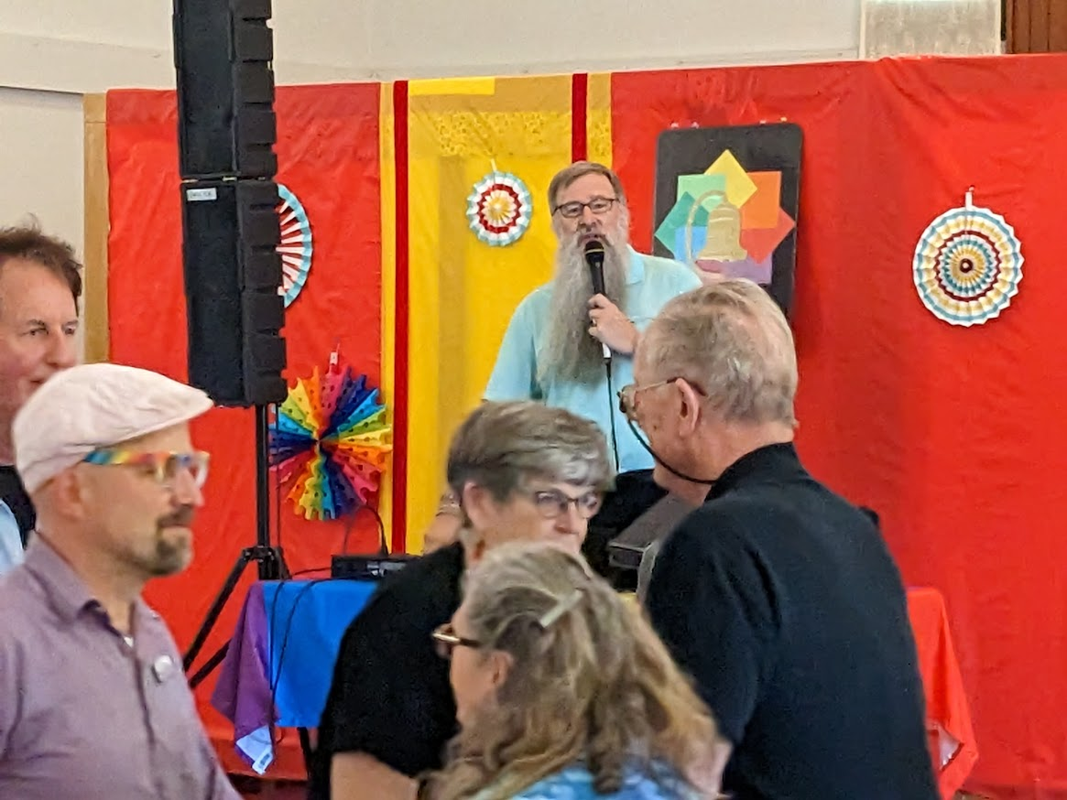
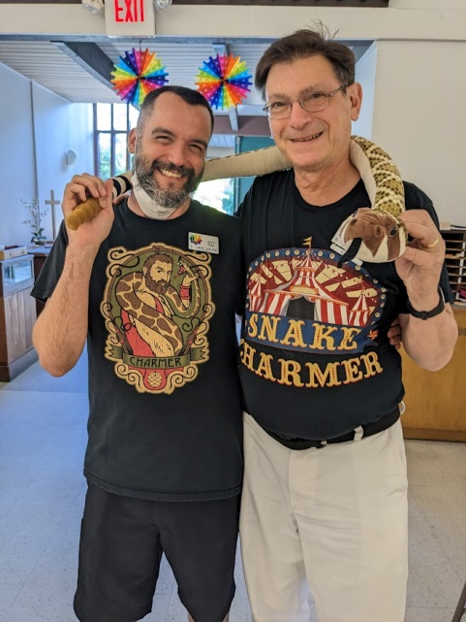
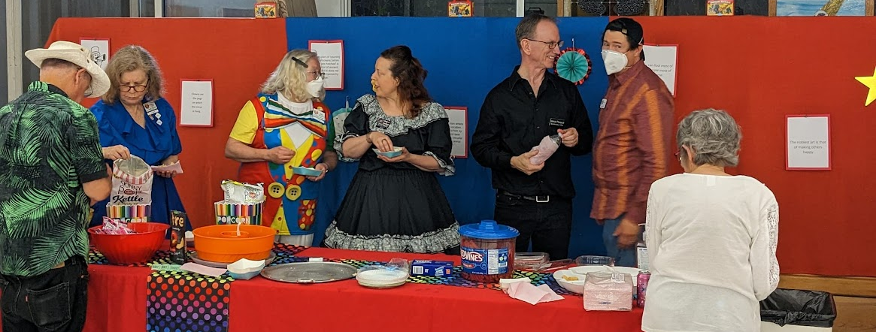
Had a Grand Square…

Slide 9
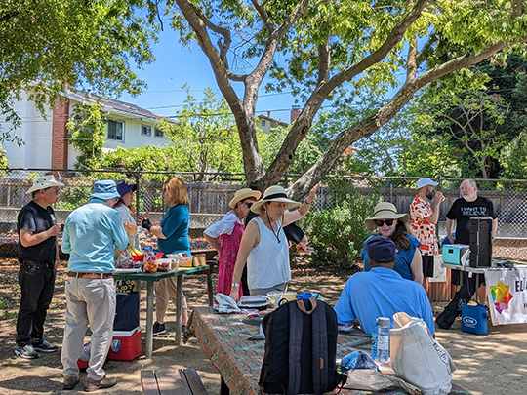
Picnicked in the park…

Slide 10
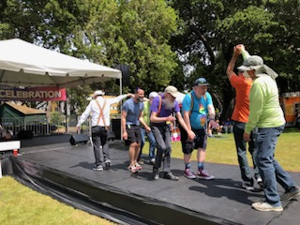
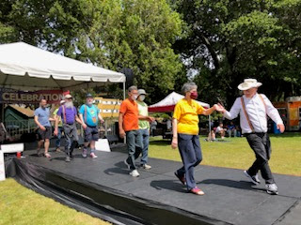
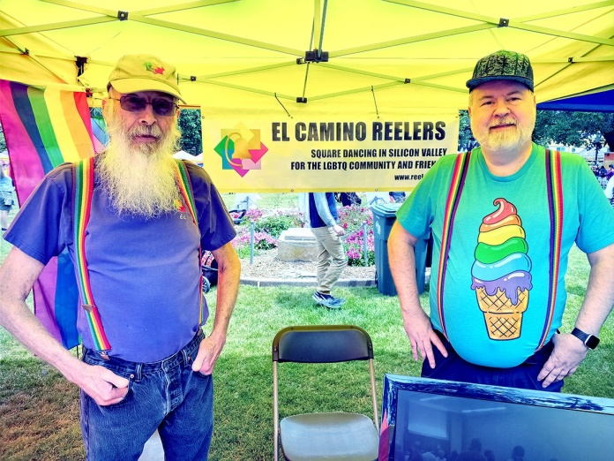
Showed our pride…
We staffed a booth and performed at San Mateo’s 11th annual Pride celebration (as we’ve done every year)

Slide 11
Went to Canada…
for the annual IAGSDC family reunion

Slide 12
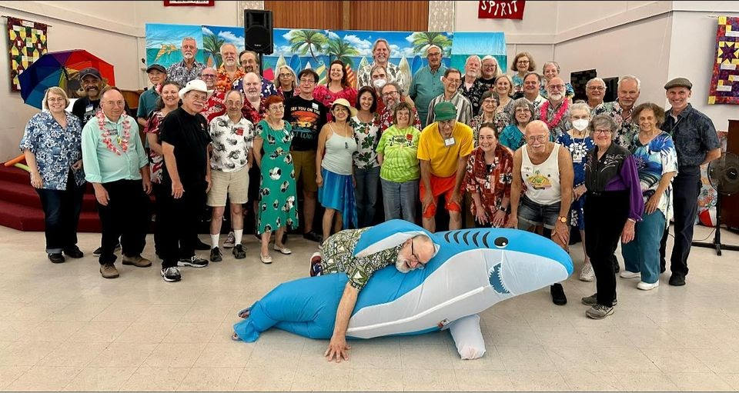
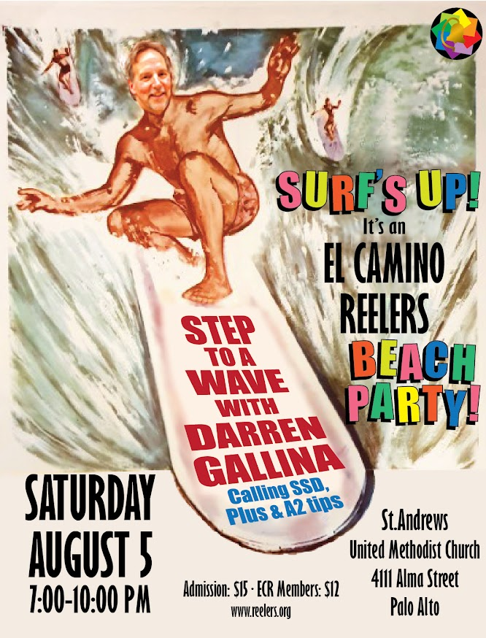
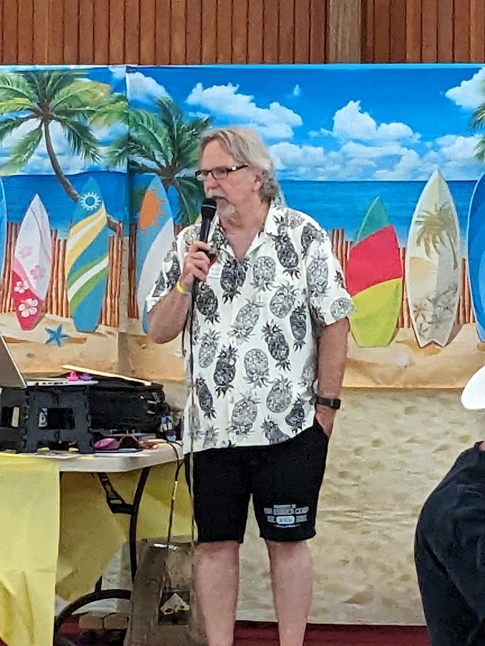
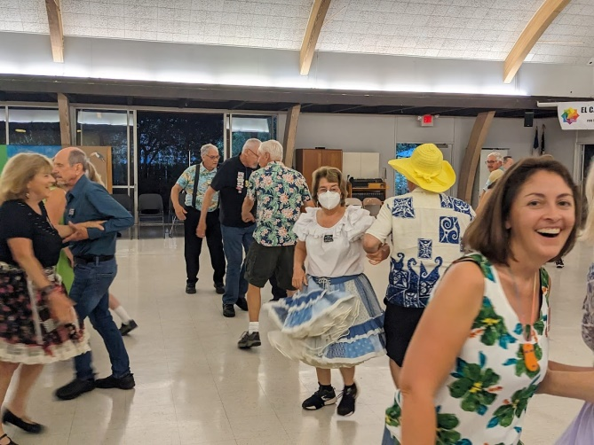
Jumped the shark…

Slide 13
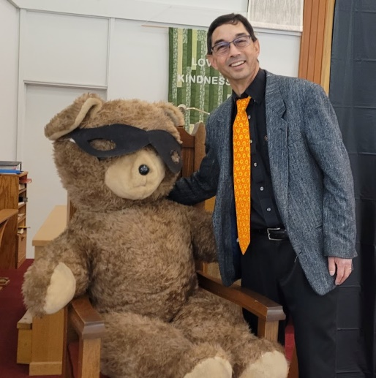
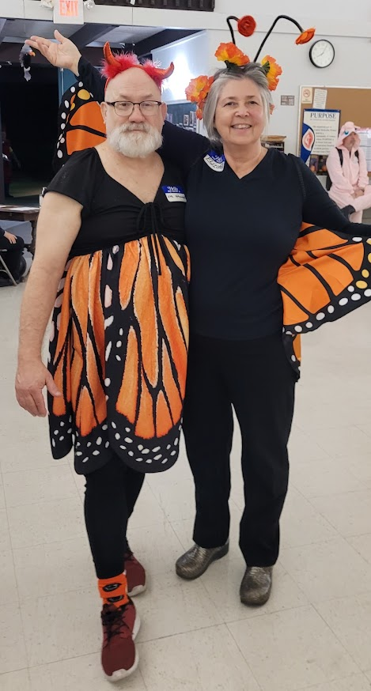
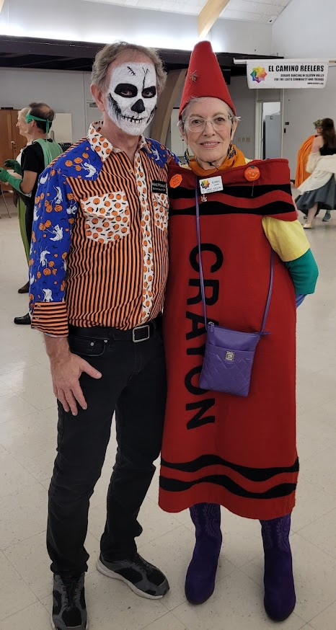
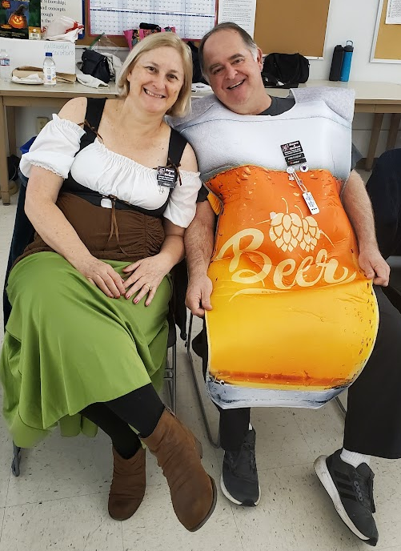
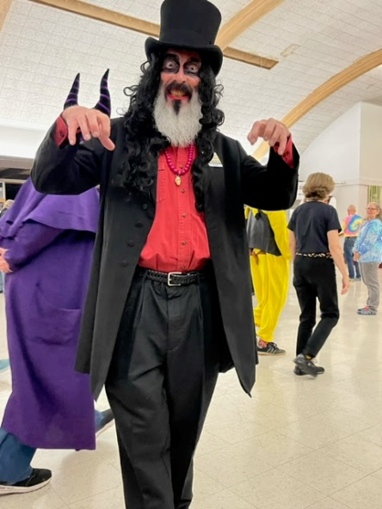
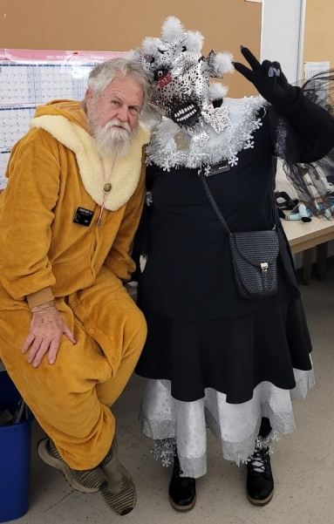
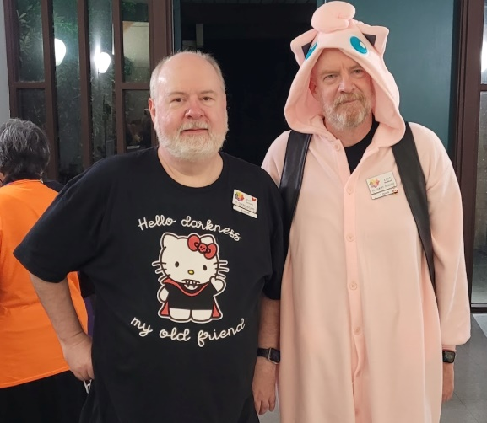
And had a ball on Halloween

Slide 14
Membership and Financial Summary
For the 2023 Calendar Year

Slide 15
Membership on the rise again
76 paid members as of January 2024
Notes:
Due to: the newbie classes, and a number of old members re-upping after the pandemic even if they don’t actually attend

Slide 16
Club Night Attendance
Usually 2 squares, sometimes more (during SSD class),
sometimes less (Thursday Plus/A2 nights)

Slide 17
Quarterly Dances
Ken Ritucci Michael Kellogg Darren Gallina Andy Allemao
Notes:
March dance: caller from East Coast, not well known here. High travel cost
May dance: conflicted with Golden State Round-up
Fall dance had disappointing turnout from ECR members
Harvest Hodown is 4th week in October

Slide 18
2023 Income & Expenses
Income: $22,202
Expenses: $19,409
Misc. Income:
Pride event: 200
Badges: 30
Beverages: 1
Dividends: 5
Misc. Expenses:
PayPal: 297
Food: 202
P.O. Box: 194
ZOOM: 150
Badges: 125
IAGSDC: 63
CA state tax: 40
Elections: 29
Net income: $2794
Notes:
Even with increased venue cost, we made money

Slide 19
Finances improving
Getting back to pre-pandemic levels
Income
Expenses

Slide 20
Balance Sheet
Net worth as of 9/30/23: $29,843

Slide 21
Board Elections
Every February

Slide 22
The ECR Board
Michael Golden (2023-25): President
Jeff Alder (2023-25): Member at Large
Robin Barrett (2022-24): Member at Large
Annette Graff (2022-24): Member at Large
Oliver Vogel (2022-24): Secretary
Ed Wilson (2023-25): Treasurer

Slide 23
About the Board
Board members serve for 2-year terms
Monthly meetings open to all ECR members – just ask!
Minutes posted at www.reelers.org/ClubInfo/ECRBoard.html
All ECR members can vote and are encouraged to run for the Board
Class planning
Dance planning & promotion
Finances & insurance
Venue management
Caller wrangling
Relations with other clubs
Elections & bylaws
Special events
Etc…

Slide 24
2024 Board Elections
Three seats open in February.
Four candidates running:
Sabra Chartrand
Rob Howe
Pete Levins
Oliver Vogel
Once again we are using a secure online voting system (ElectionBuddy.com)
Ballot notices will be sent out after the General Meeting to each paid-up member’s email address
Results will be announced February 27

Slide 25
Club History Project
We want to acknowledge long-term members with an anniversary bar to hang from your badge – 5, 10, 15 years…
If you haven’t done so already, please verify with Eric Hudson that your membership dates are accurately recorded.
On hold for now…
Notes:
Anything new?

Slide 26
You can help
Even if you don’t want to serve on the board, there are lots of ways to help the club
Volunteer to help at dances & classes
Staff the ECR booth at Pride events
Outreach to LGBTQ community and workplace organizations
Invite your friends to Open House!
And more… just ask!

Slide 27
The Future…
Where are we going in 2024

Slide 28
Our Goals
Four main goals for the club:
Continue the feeling of family among our members
Increase membership
Increase opportunities for our members to dance
Increase the dancing strength of our members

Slide 29
Our Classes
SSD-to-Plus class
Started January 9
Currently at 7 students
Expected to finish in late May (20 weeks)
Beginner class
TBA for late summer/early fall
There will be Open House nights
Tell your friends!
Is there interest in an Advanced class?

Slide 30
Coming in 2024
February 24: The Black & White (and Pink) Ball with Bill Eyler
May 18: Eric Henerlau
July 4-7: IAGSDC Convention, Durham NC
Aug. 3: Kris Jensen
Oct. 26: Vic Ceder (Halloween Ball)
Picnics & Tea Dances!

Slide 31
The Return of the Potluck
Our January potluck (first since the pandemic) was a big success.
We plan to hold Friday potlucks about once a month.
February 9 (This Friday!)
March 15

Slide 32
Acknowledgments
The Board would like to thank…
Notes:
THIS ALL NEEDS TO BE UPDATED

Slide 33
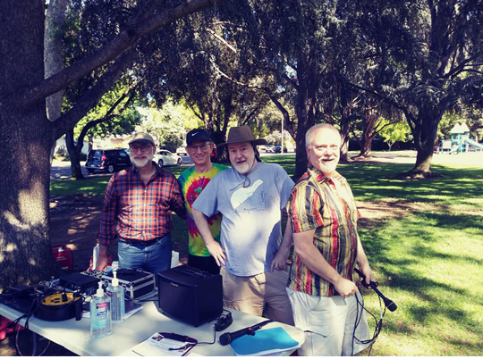
Thanks to our Club Callers…
Dave Decot
Kurt Gollhardt
Michael Levy
Mike Pogue
James Thompson
Special thanks to Kurt for managing the club caller schedule

Slide 34
Retiring Board Members
Annette Graff and Robin Barrett are stepping away from the Board – thank you for your support of ECR!

Slide 35
And many thanks to…
Everybody who brings food (Sheri & Hank, this means you!)
Everybody who helps out at dances (decorations, 50-50 raffle, cleanup)
Everybody who attends Board meetings (just ask!)
All our other volunteers
All our generous donors
… AND ALL OUR DANCERS!
Notes:
Updates?

Slide 36
ANY QUESTIONS?

Slide 37
THAAAANK YOU!!

