Slide 1

EL CAMINO REELERS
GENERAL MEETING
TUESDAY, FEBRUARY 4, 2025

Slide 2
Agenda
2024 in Review (Michael)
Membership & Financial Summary (Ed)
Board Elections & ways to help (Oliver)
Coming in 2025 (Pete)
Acknowledgments (Jeff)
Notes:
Who’s going to present what?

Slide 3
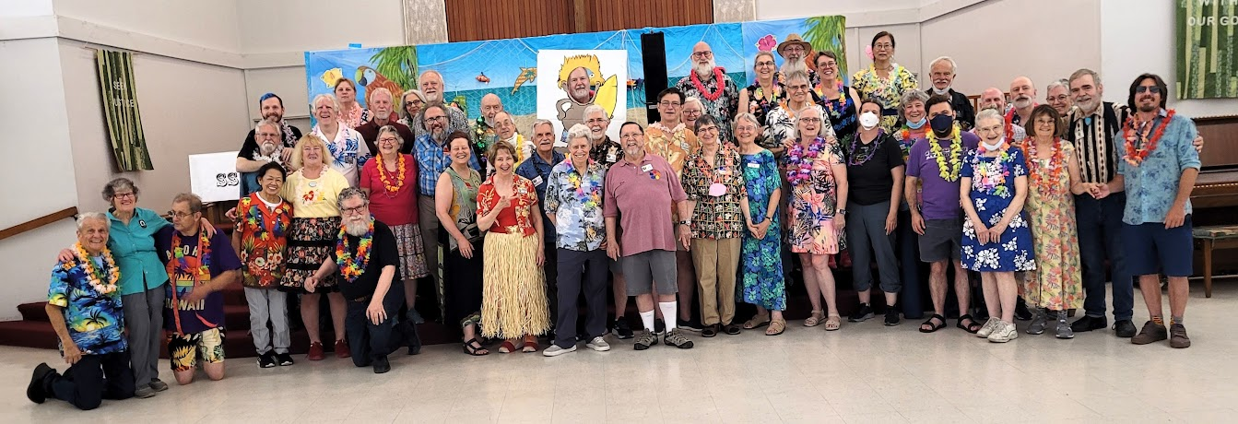
2024 in Review
What did we do last year?

Slide 4
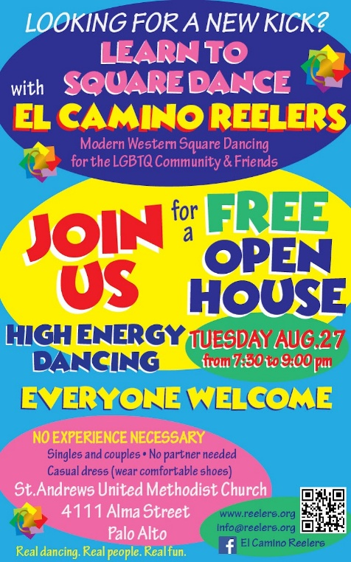


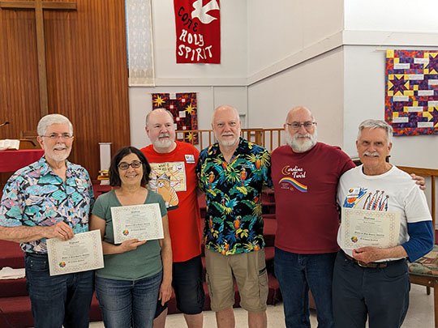

Growing the club
Growing our membership was priority #1
Open House nights in April, May and August
SSD-to-Plus Class: January-May (follow-on to last year’s beginner class)
“Green” Beginner class: September-December
Focus on class level dancing on Tuesday club nights

Slide 5
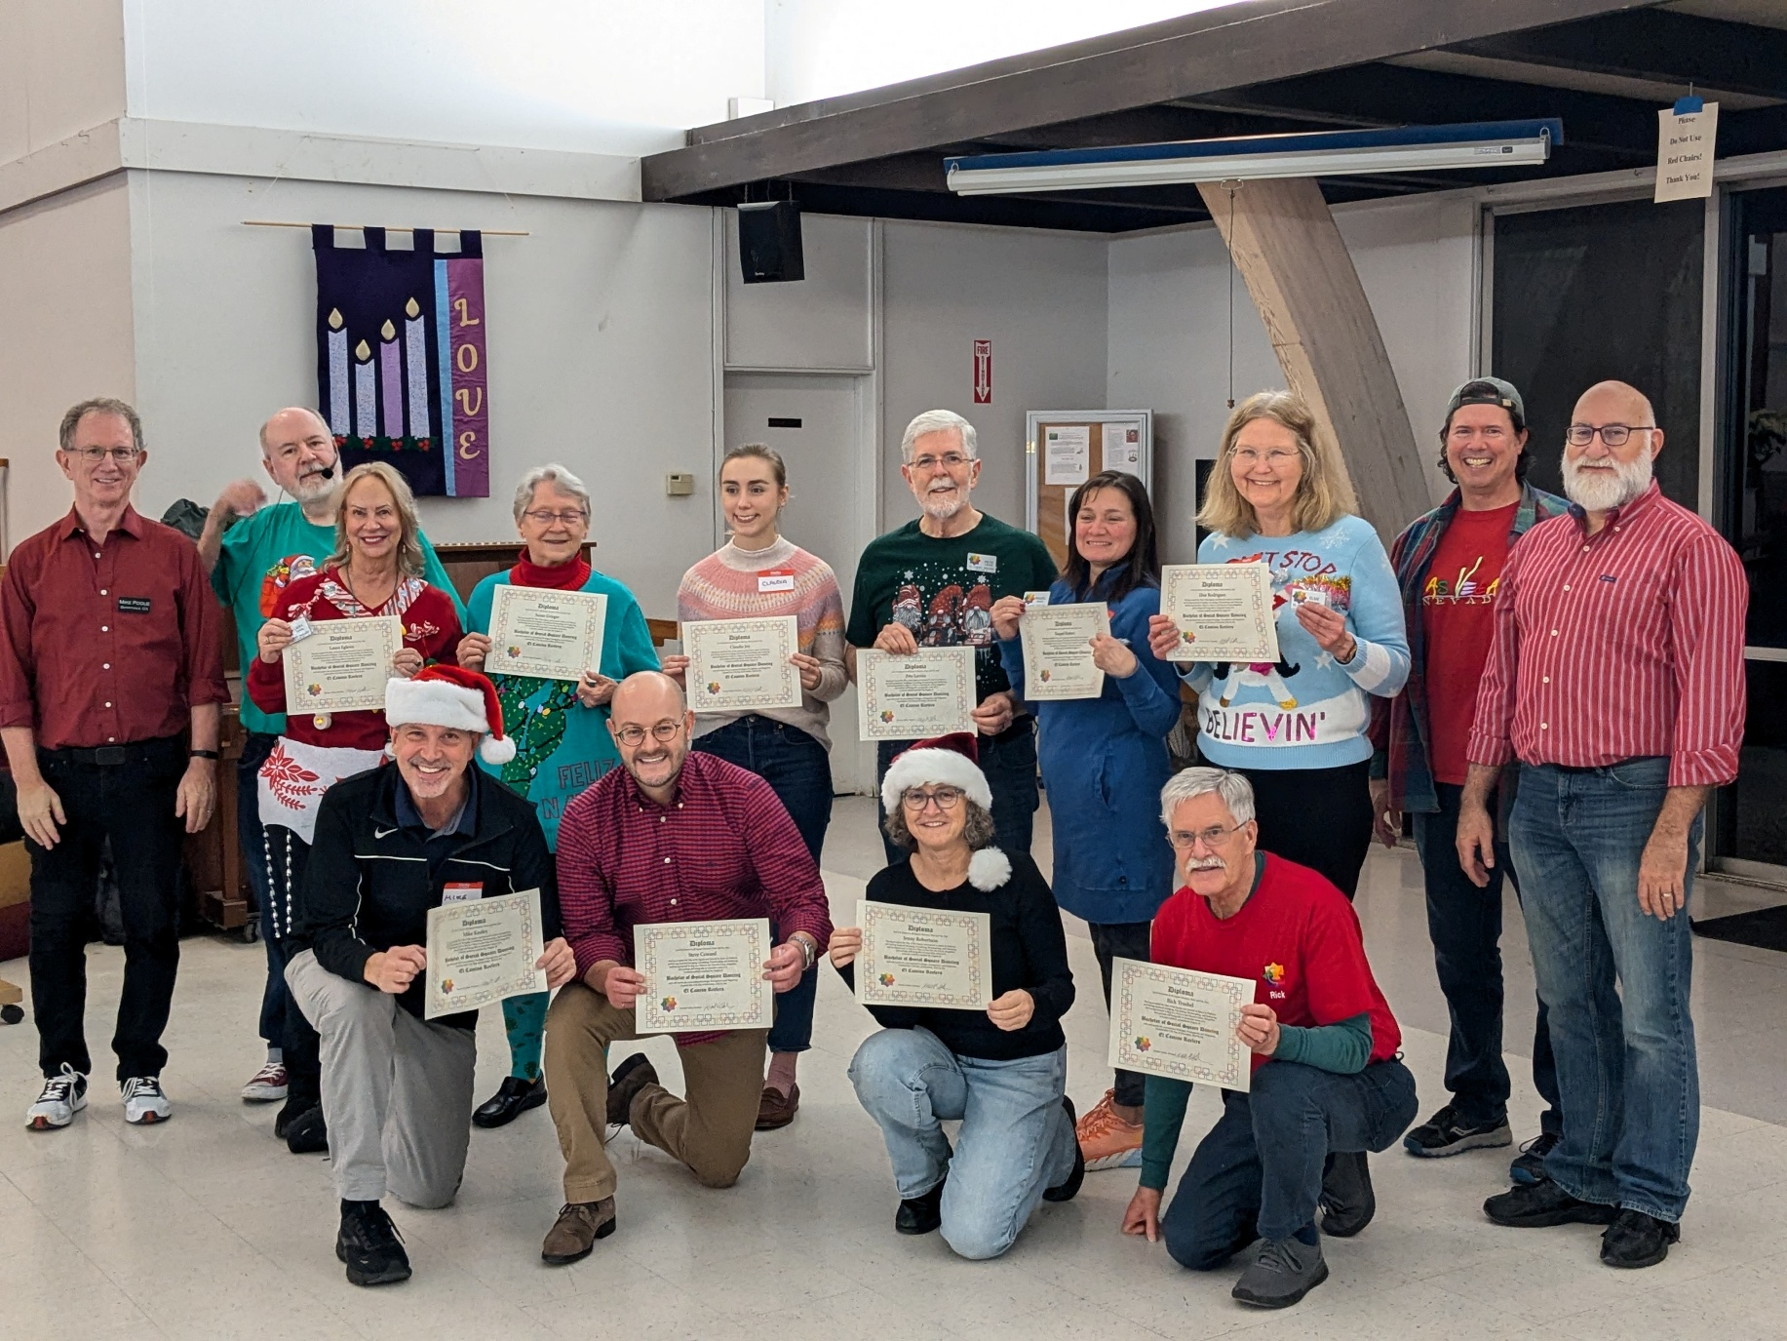
Our largest SSD class in years!

Slide 6
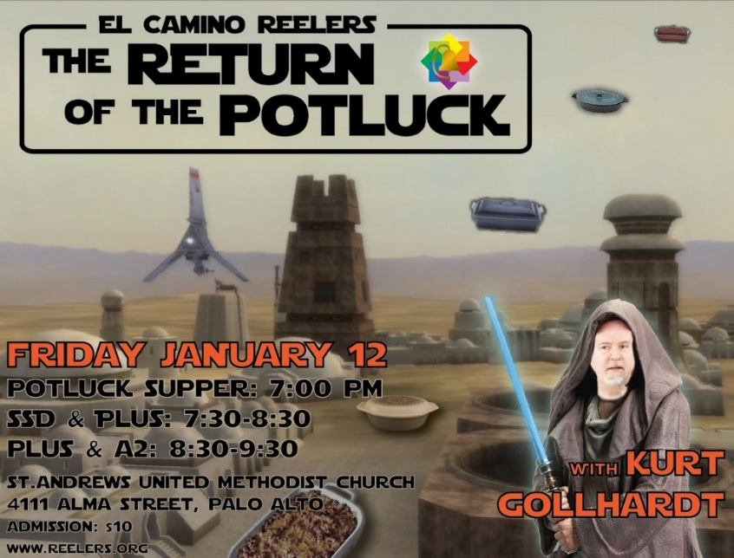



The Return of the Potluck
After pausing during COVID, we resumed holding Friday potlucks – more opportunities for Plus & A2 dancing

Slide 7


Tea Dances at BillyDeFrank
Two Sunday afternoon Plus-A2 dances at the Billy DeFrank LGBTQ+ Center in San Jose

Slide 8

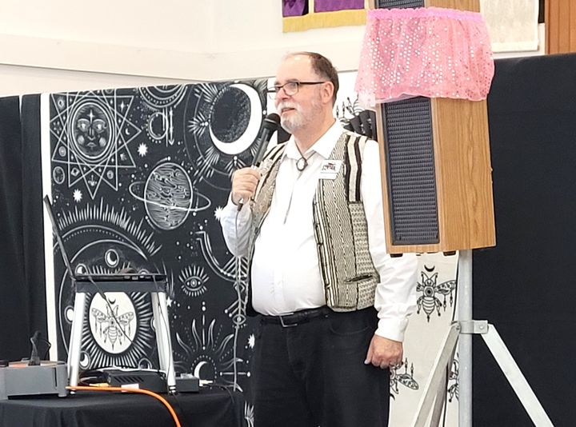
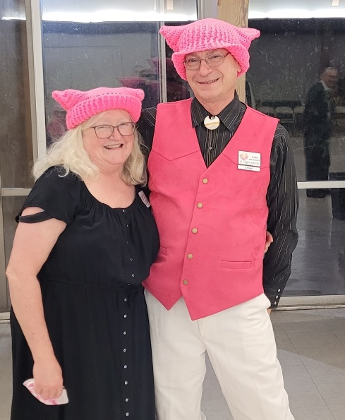
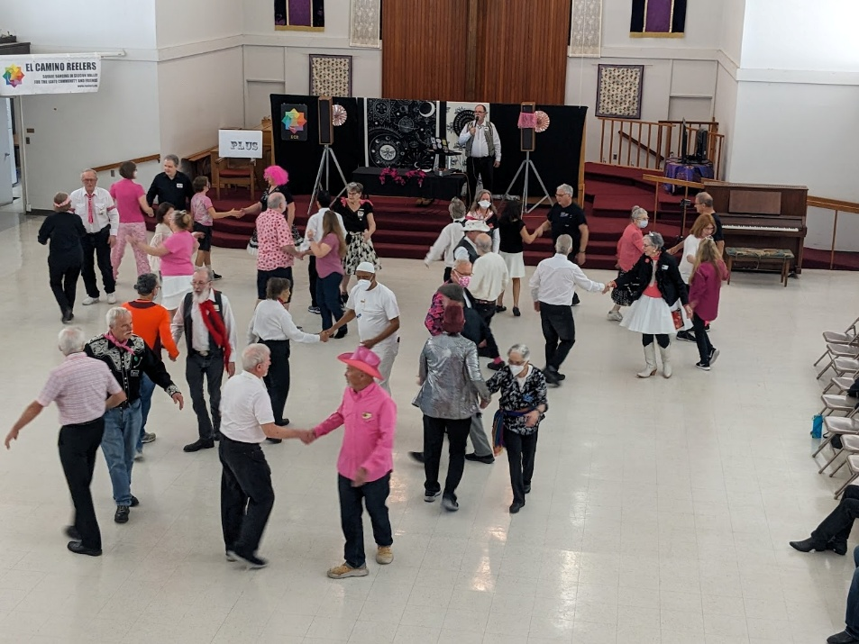
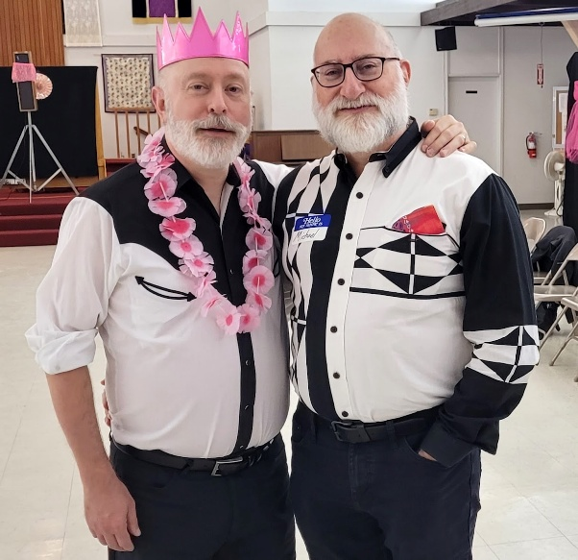
Pretty in Pink
Bill Eyler, Feb. 24

Slide 9
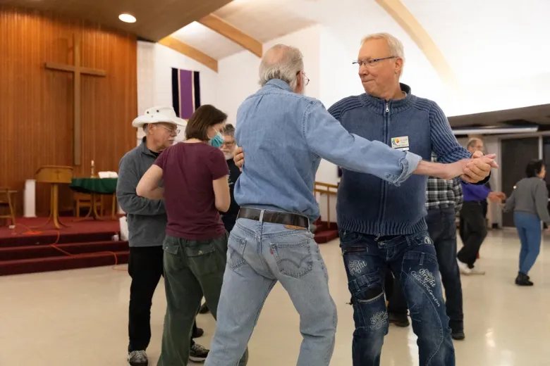
Free Publicity
Cover article in Palo Alto Weekly (March 21) drew attention to the club

Slide 10
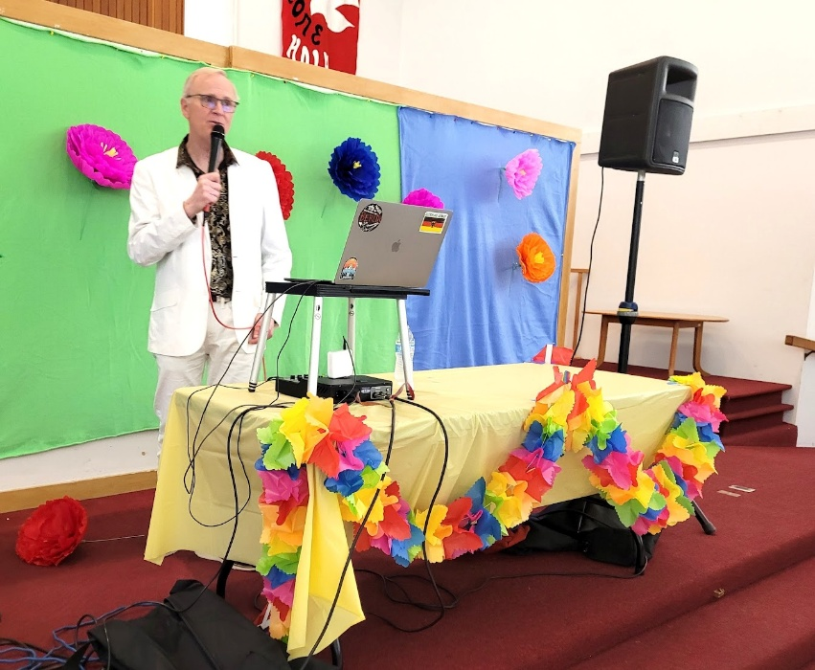
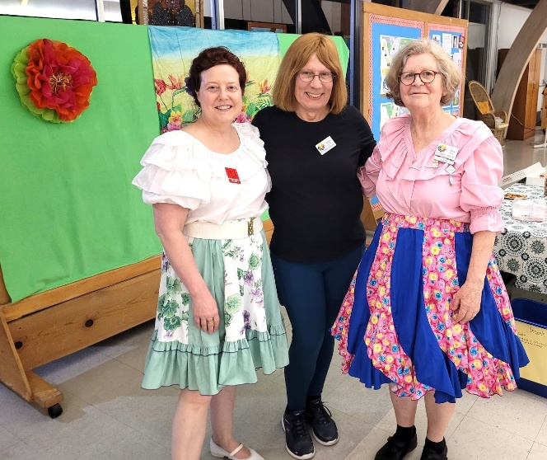

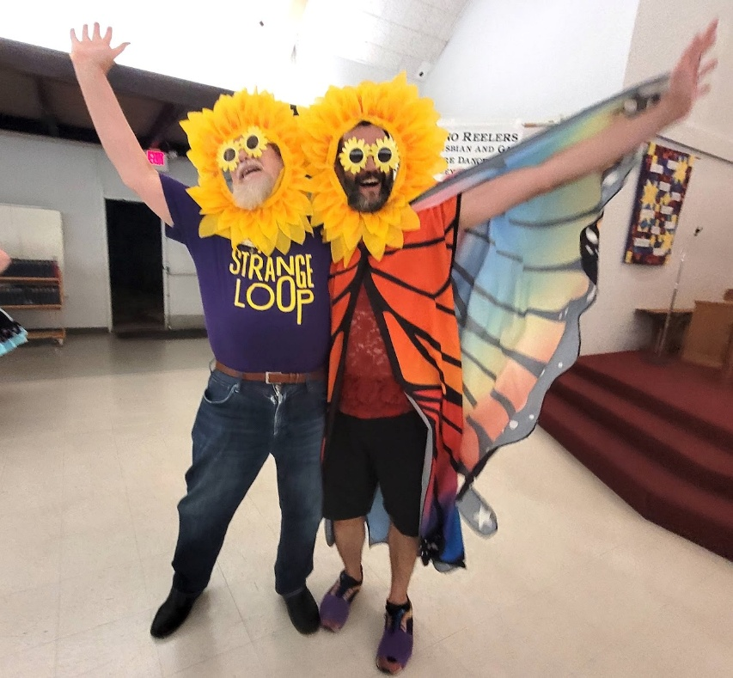
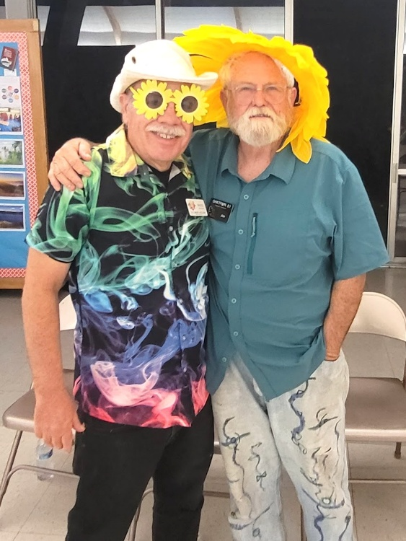
Spring Flowers
Eric Henerlau, May 18

Slide 11
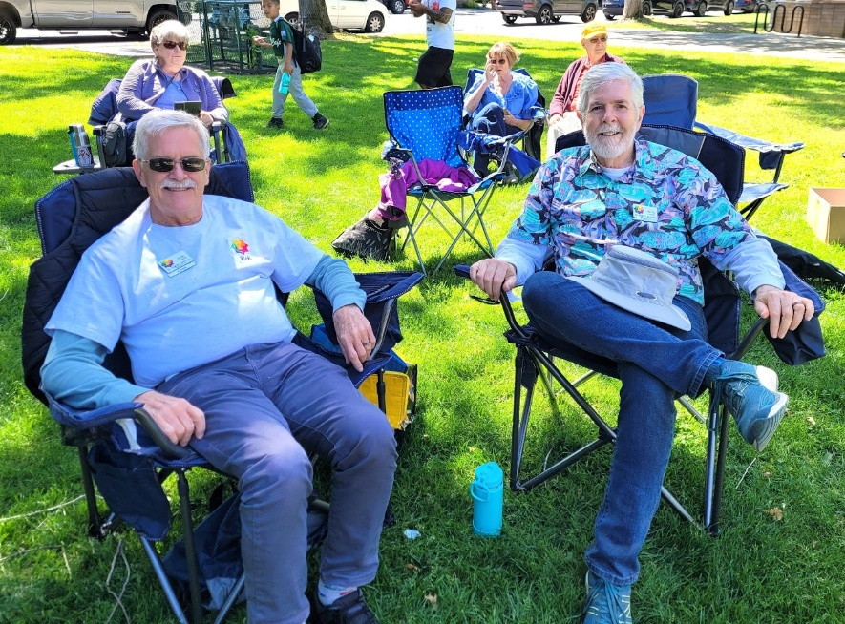
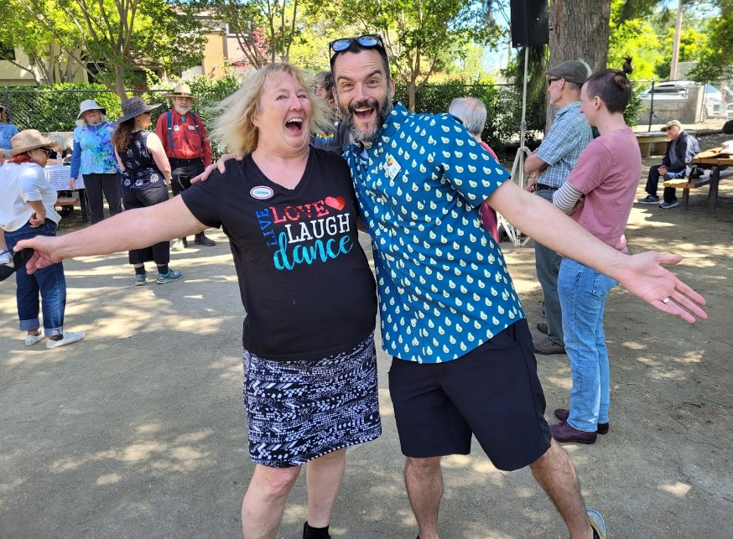
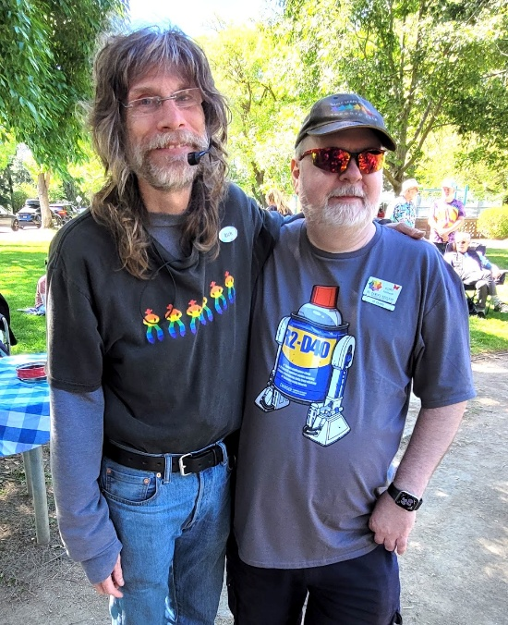
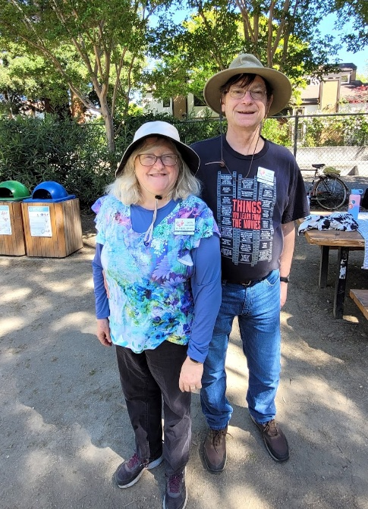
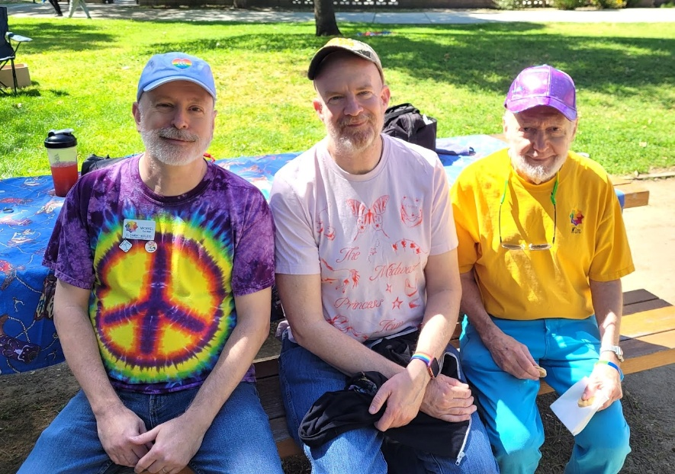
Three Picnics in the Park

Slide 12
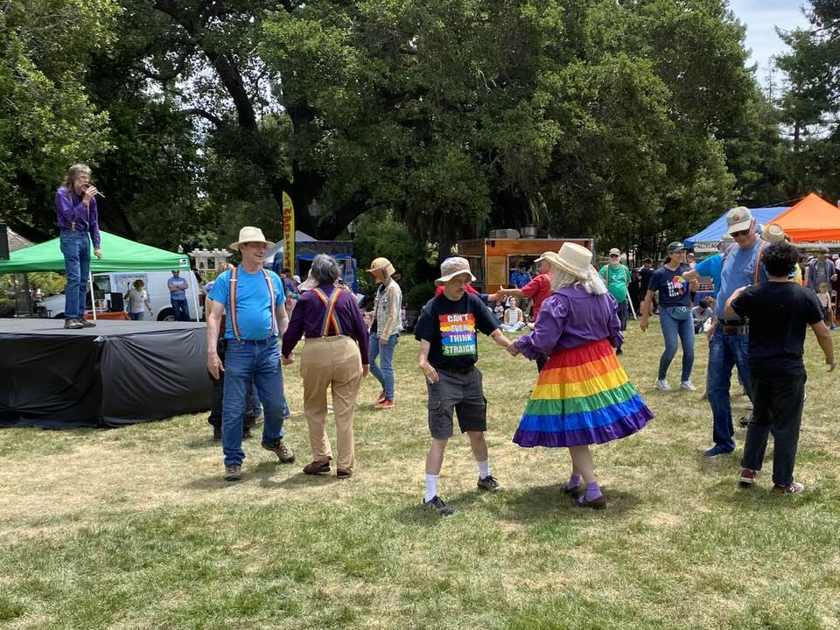
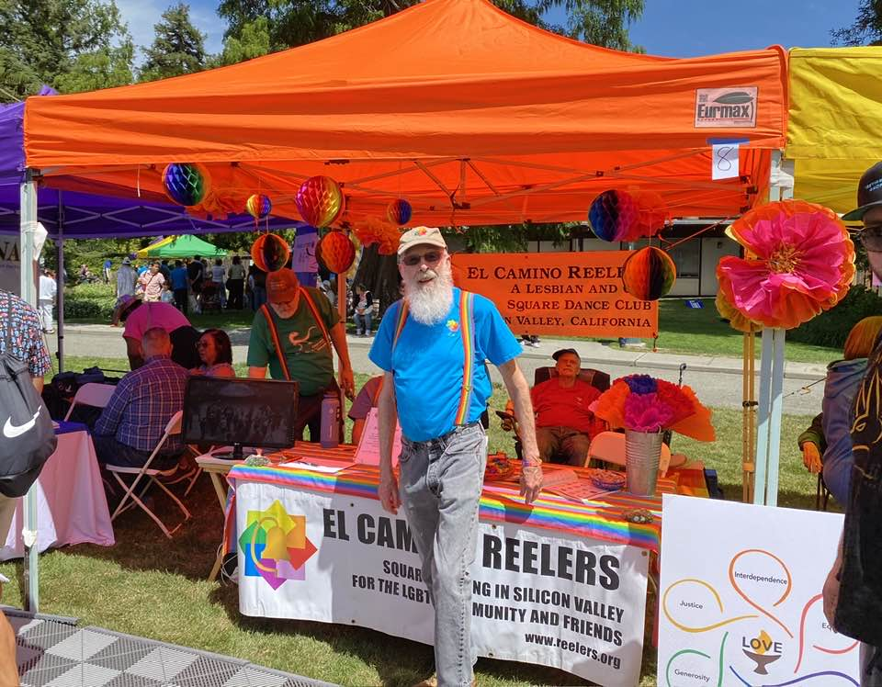
Two Pride events
Staffed a booth and performed at San Mateo Pride (our 12th) and Fremont Pride (their first)

Slide 13
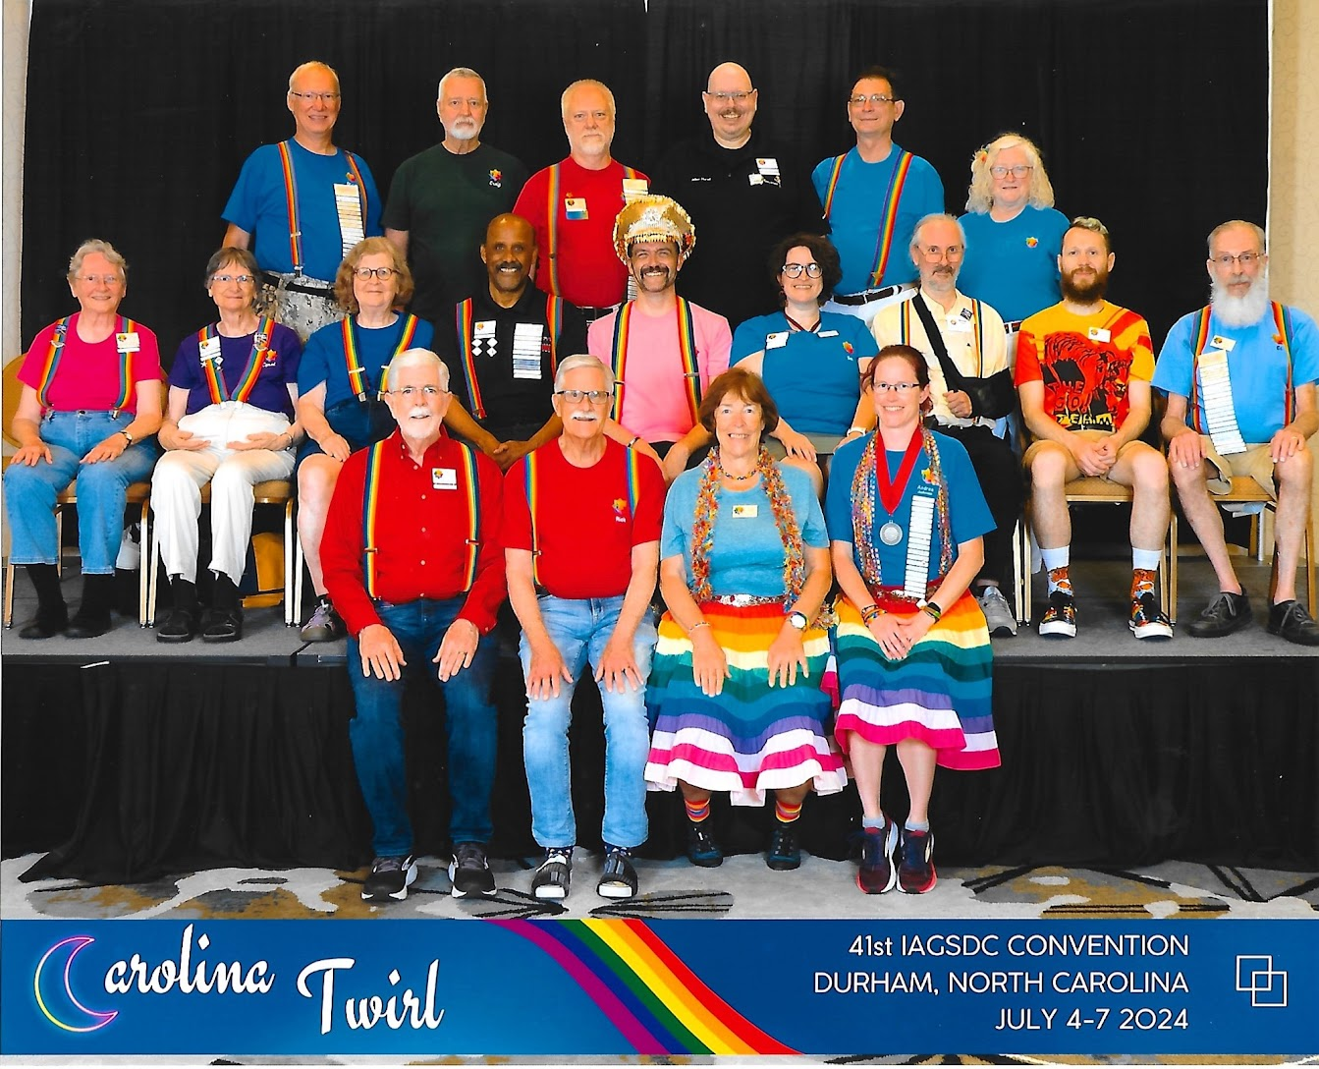
Twirling in North Carolina
at the IAGSDC Convention in Durham NC

Slide 14
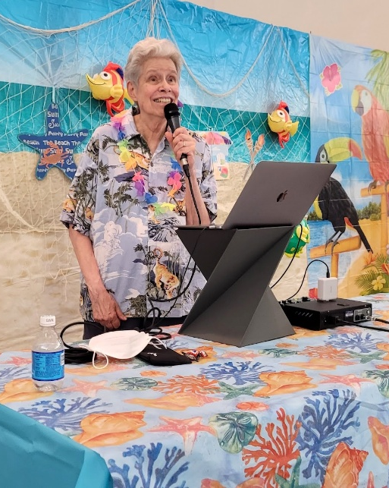
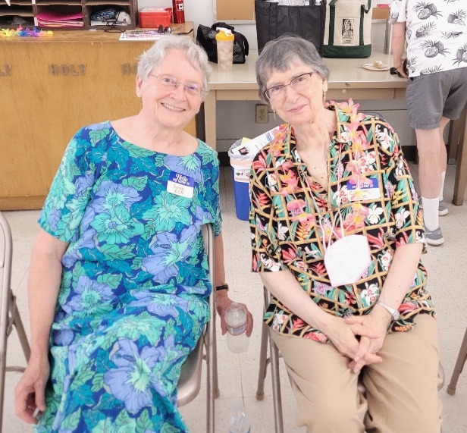
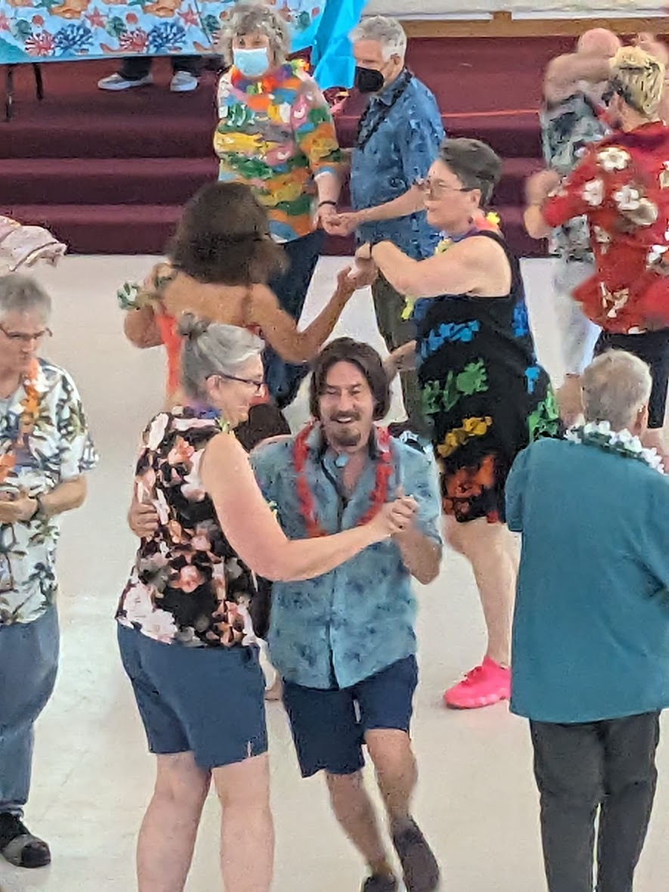
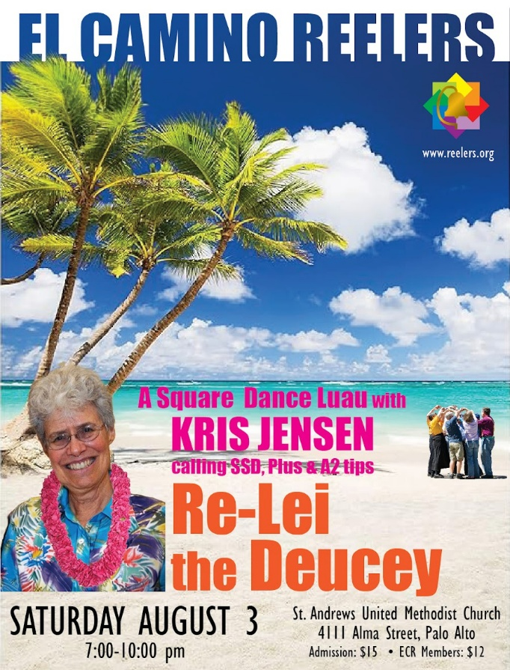
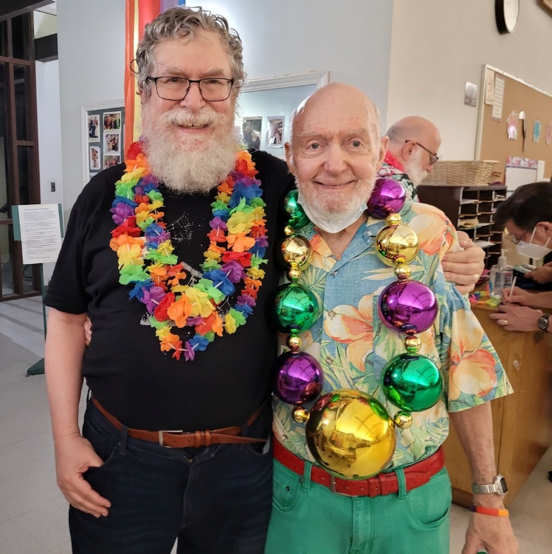
Re-Lei the Deucey
Kris Jensen, Aug. 3

Slide 15
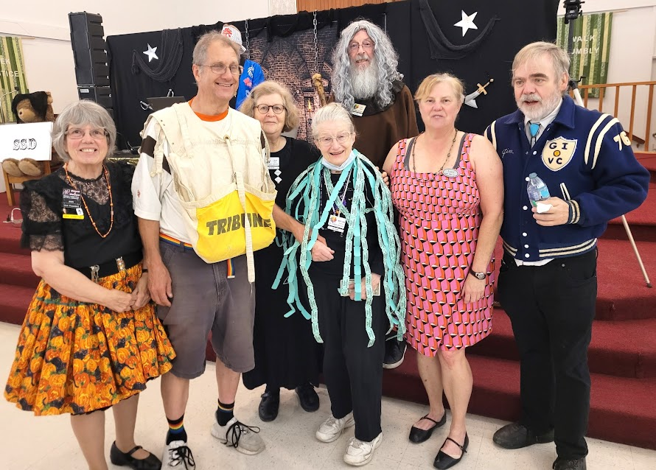

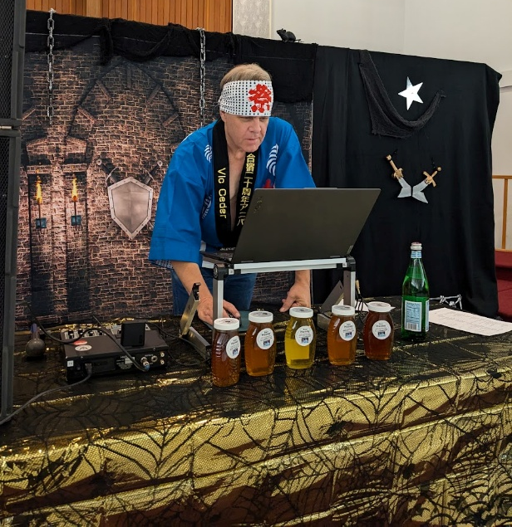
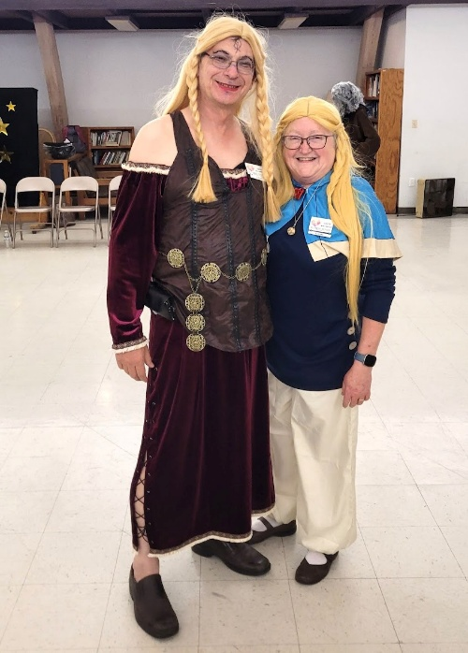
Dungeons & Drag Queens
Vic Ceder, Oct. 26

Slide 16
Membership and Financial Summary
For the 2024 Calendar Year

Slide 17
Membership holding steady
72 paid members as of December 2024
Gained 18 new members, but several people from the 2022-2023 beginner classes dropped out; we lost several members due to age/disability

Slide 18
Club Night Attendance
Usually 2 squares, sometimes more
Includes regular club nights, Open House nights, potluck & tea dances

Slide 19
Member Attendance
Out of 72 paid club members, 13 never come but still pay dues every year
(“Regular” and “Occasional” are highly subjective)

Slide 20
Quarterly Dances
Bill Eyler Eric Henerlau Kris Jensen Vic Ceder

Slide 21
2024 Income & Expenses
Income: $20,779
Expenses: $19,574
Misc. Expenses:
Facilitator: 500
PayPal: 205
Bank Fees: 83
Food: 10
P.O. Box: 200
ZOOM: 160
Badges: 268
IAGSDC: 73
Fed & CA tax: 40
Elections: 29
Misc. Income:
Badges: 45
Dividends: 5
Net income: $1205
Notes:
Even with increased venue cost, we made money
Misc expense numbers don’t add up. Check further

Slide 22
Income and Expenses
Stabilizing after the pandemic
Income
Expenses

Slide 23
Balance Sheet
As of the end of our fiscal year (Sept. 30)
Net worth as of 9/30/24: $33,730

Slide 24
Board Elections (and more ways to help)
Every February

Slide 25
The ECR Board
Michael Golden (2023-25): President
Oliver Vogel (2024-26): Secretary
Ed Wilson (2023-25): Treasurer
Jeff Alder (2023-25): Member at Large
Rob Howe (2024-26): Member at Large
Pete Levins (2024-26): Member at Large

Slide 26
About the Board
Board members serve for 2-year terms
Monthly meetings open to all ECR members – just ask!
Minutes posted at www.reelers.org/ClubInfo/ECRBoard.html
All ECR members can vote and are encouraged to run for the Board
Class planning
Dance planning & promotion
Finances & insurance
Venue management
Caller wrangling
Relations with other clubs
Elections & bylaws
Special events
Etc…

Slide 27
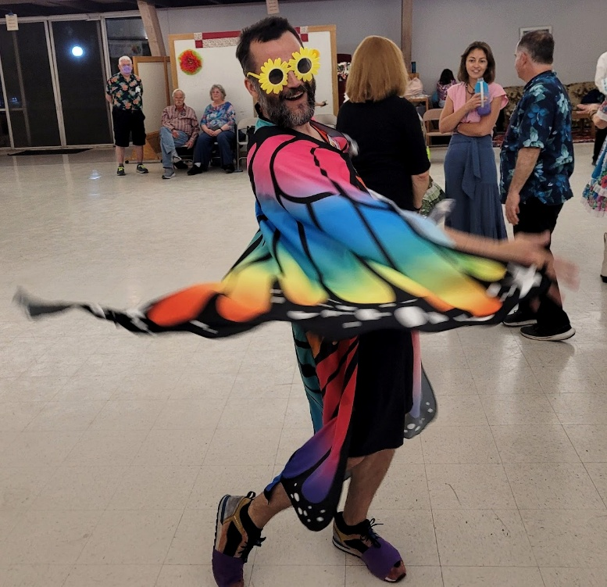
Retiring Board Member
Jeff Alder is stepping away from the Board – thank you for all your work for ECR!
(He’s still handling the Club Logo Merchandise program)

Slide 28
2025 Board Elections
Three seats open in February
Two board members running again
Michael Golden
Ed Wilson
We are looking for more candidates
We are using a secure online voting system (ElectionBuddy.com)
Ballot notices will be sent out February 11 to each paid-up member’s email address
Results will be announced February 25

Slide 29
You can help
Even if you don’t want to serve on the board, there are lots of ways to help the club
Volunteer to help at dances & Blast classes
Staffing the ECR booth at Pride events
Follow up with prospective new dancers
Host an out-of-town caller
Outreach to LGBTQ community and workplace organizations

Slide 30
More ways to help
Class coordinator
Follow up with students who missed class
Communicate issues raised by students
Club “stepmother”
Recognize birthdays etc.
Check in with missing members
Social organizer (for non-dance events)
And more… just ask!

Slide 31
Coming in 2025
What’s in store for ECR

Slide 32
Our Goals
Three main goals for the club:
To increase membership
To increase the dancing strength of our members
To continue the feeling of family amongst our members

Slide 33

Our Classes
SSD-to-Plus Blast class
Partnering with Oaktown 8s
Four Saturdays starting Feb. 15
Currently at 12 students
Angels needed! (and dance FREE)
Beginner class
TBA for late summer/early fall
Open House nights (April, June, August)
Tell your friends!

Slide 34

2025 Dances
March 22: ECR 40th Anniversary Dance and Potluck with Michael Kellogg
May 3: Barry Clasper
Aug. 23: Darren Gallina
Nov,1: Halloween Ball with Buddy Weaver
Potlucks, Picnics & Tea Dances!

Slide 35
ECR logo apparel
T-shirts and other ECR logo apparel will go on sale in March
April 15 order deadline
Delivery in late May
See the Merchandise page on www.reelers.org. Prices and items are not final yet.
Questions? See Jeff

Slide 36

Pride Events
We will be dancing (and staffing booths) at
June 7: Mountain View Pride (new)
June 14: San Mateo County Pride
Other Pride events TBD

Slide 37

2025 IAGSDC Convention
In San Francisco July 3-6 at the Marriott Marquis
Special discount rate for first-timers
Sign up and reserve your hotel room now! https://hitchhikeacrossthegalaxy.com

Slide 38
Acknowledgments
The Board would like to thank…

Slide 39
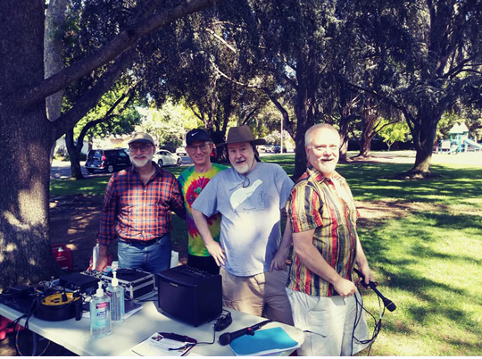
Thanks to our Club Callers…
Dave Decot
Kurt Gollhardt
Michael Levy
Mike Pogue
James Thompson
Special thanks to Kurt for managing the club caller schedule

Slide 40
Richard Wegener
Richard Wegener passed away July 13, 2024 from complications related to a fall.
Richard and Mary Jane joined ECR in 2012. They belonged to many other local square dance clubs.
They were married for 45 years.

Slide 41
Club History Project
We want to acknowledge long-term members with an anniversary bar to hang from your badge – 5, 10, 15 years…
If you haven’t done so already, please verify with Eric Hudson that your membership dates are accurately recorded.

Slide 42
2025 Longevity Awards
40 Years
Bob Kanefsky
Stewart Kramer
Frank Yellin
20 Years
Kurt Gollhardt
Susan Grieger
Pete Levins
15 Years
Lynn Ashmall
René Drolet
Steven Higaki
10 Years
Frank Krause
Don Margolin
Hank Winkenwerder
Sheri Winkenwerder

Slide 43
And many thanks to…
Everybody who brings food
Everybody who helps out at dances (decorations, 50-50 raffle, cleanup)
Everybody who attends Board meetings (just ask!)
The Election Committee and other volunteers
All our generous donors
… AND ALL OUR DANCERS!

Slide 44
ANY QUESTIONS?

Slide 45
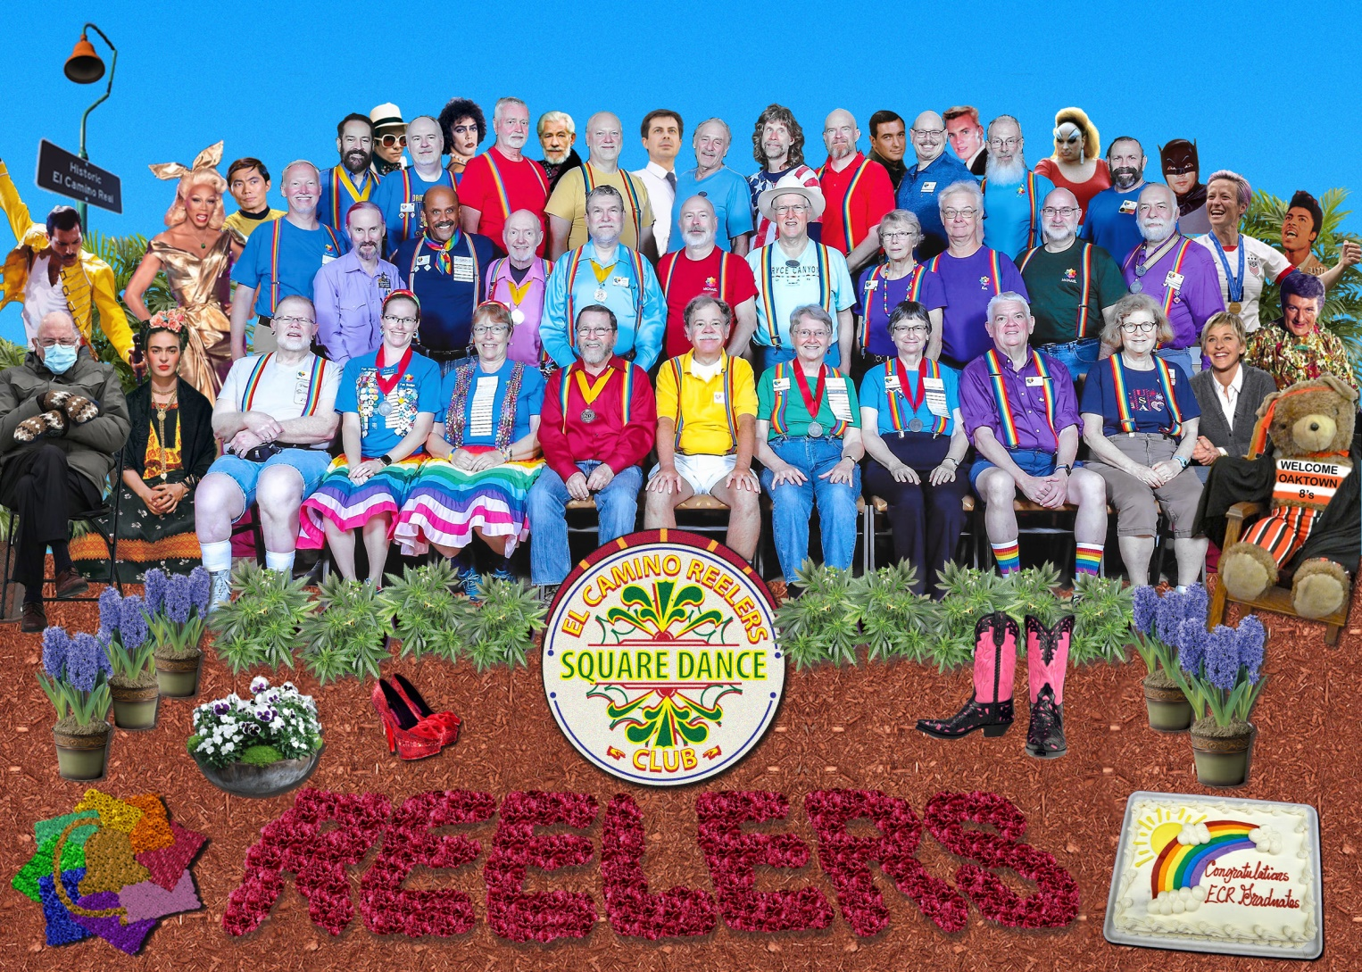
THAAAANK YOU!!

